Slide 1


Slide 2


Create a web UI with ASP.NET Core
Jon Galloway & Maira Wenzel

Slide 3
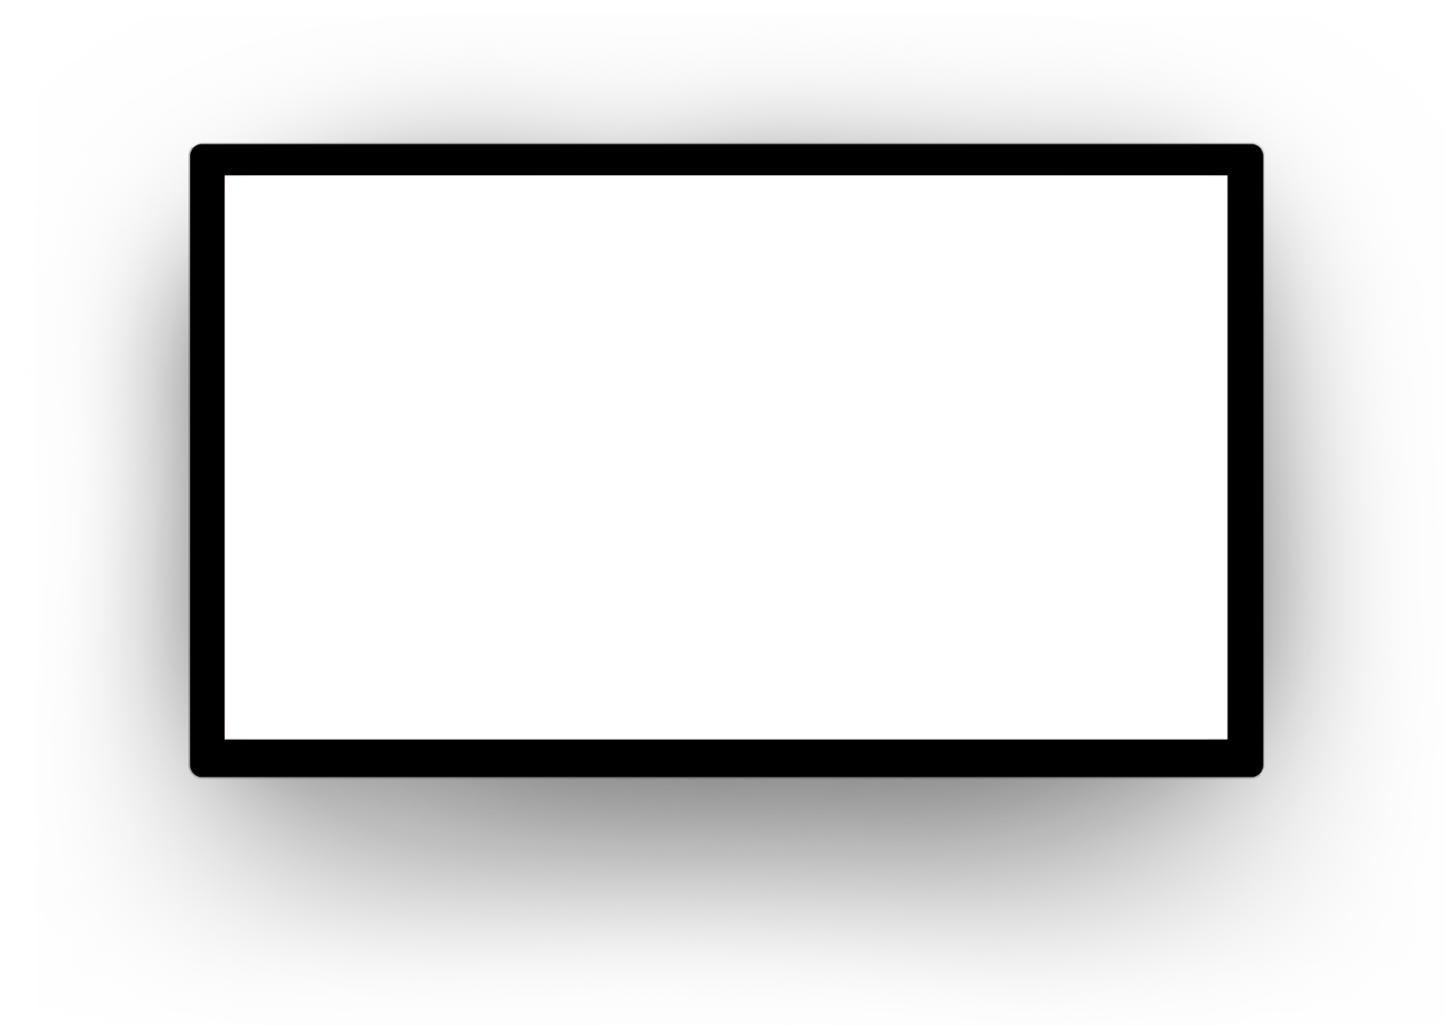
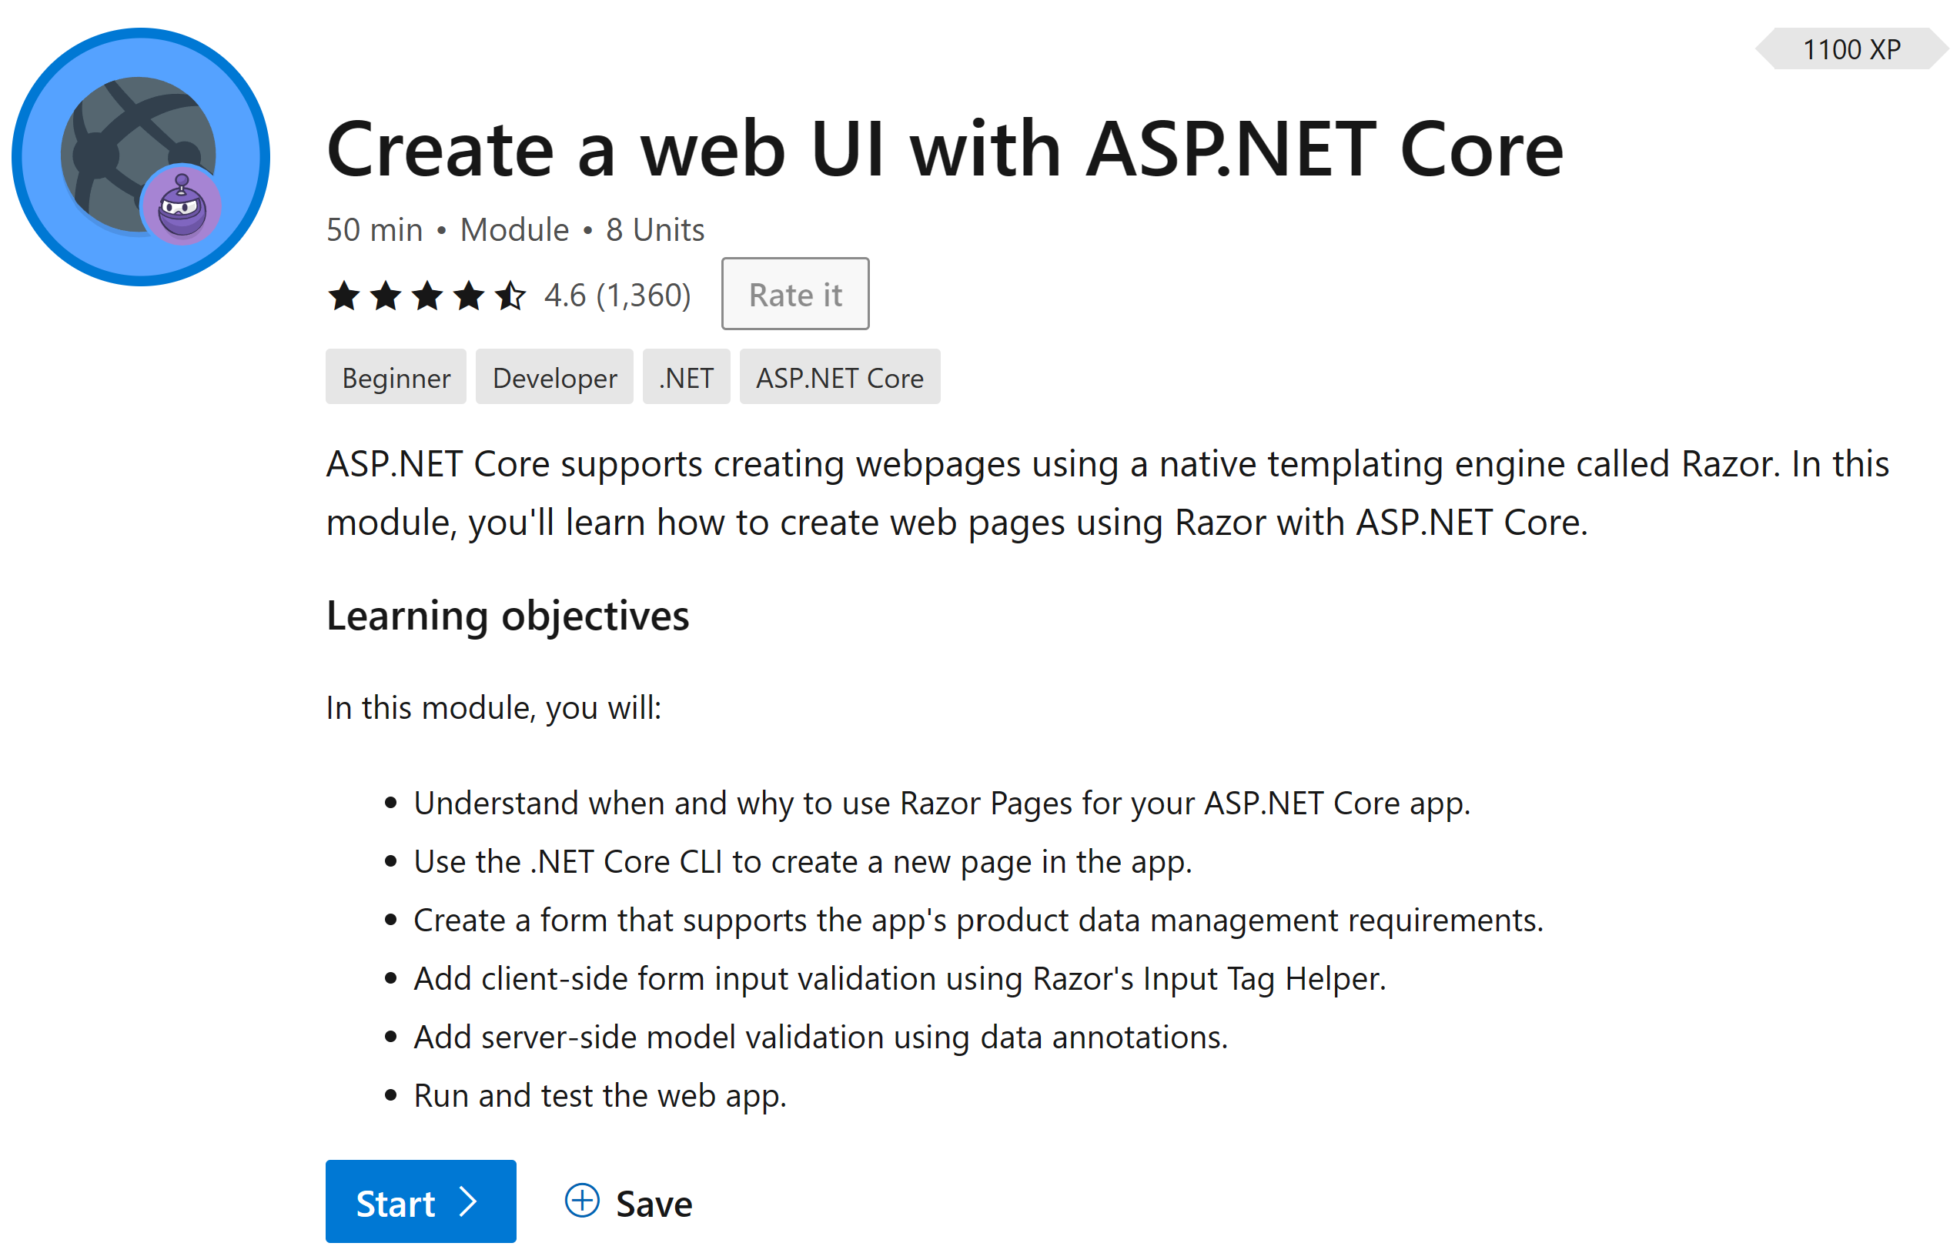
/learn
https://aka.ms/dotnet-conf-webUI
Complete interactive learning exercises, watch videos, and practice and apply your new skills.
Notes:
What is a Learn Module
Promote the Learn module. Encourage the audience to complete the module AFTER the session. They’ll be able to do everything that we’re doing here today, and get hands-on experience to reinforce their learning.

Slide 4

Live & interactive
Say “hi” and ask questions in the chat
Notes:
As a reminder this is a live interactive session, so please make sure you head over to chat say ‘hi’ and ask any questions you might have as we go through the material.
We will answer questions as we go through, but even if we don’t get to them we have a team of moderators who are subject matter experts who will be answering questions in the chat also.

Slide 5

Scenario
Develop a pizza inventory management page
Notes:
Suppose you're an employee of a pizza company named Contoso Pizza. Your manager has asked you to develop a pizza inventory management page as a prerequisite for the company's internal admin website. The app should be built in such a way that the view and data model concerns are separated.

Slide 6




What will we be doing?
Understand when and why to use Razor Pages for your ASP.NET Core app.
Use the .NET CLI to create a Razor Pages app.
Create a form that supports the app's product data management requirements.
Run and test the web app
Notes:
In this module, you will:
Understand when and why to use Razor Pages for your ASP.NET Core app.
Use the .NET CLI to create a Razor Pages app.
Create a form that supports the app's product data management requirements.
Run and test the web app.
At the end of this module, there are links to content providing deeper dives for each feature area introduced.

Slide 7
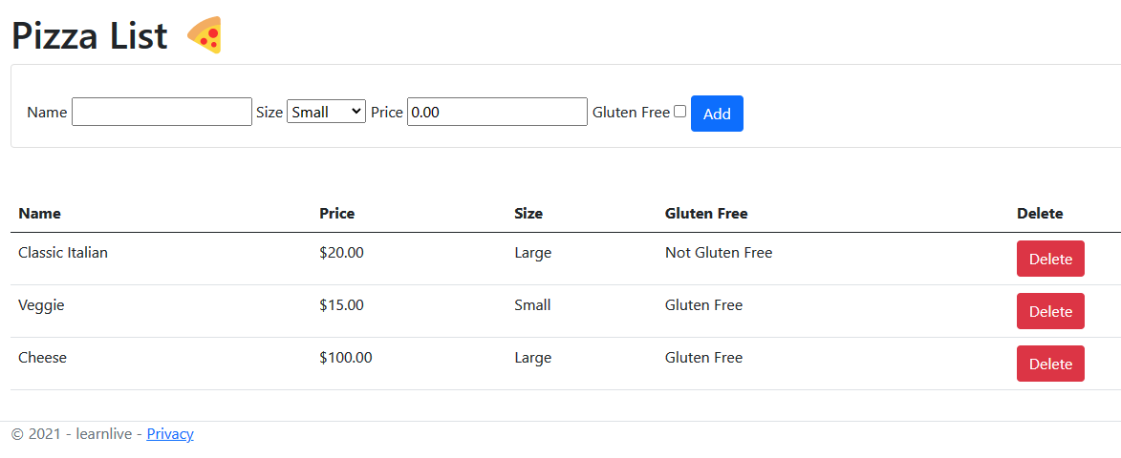
Notes:
In this module, you will:
Understand when and why to use Razor Pages for your ASP.NET Core app.
Use the .NET CLI to create a Razor Pages app.
Create a form that supports the app's product data management requirements.
Run and test the web app.
At the end of this module, there are links to content providing deeper dives for each feature area introduced.

Slide 8
Understand when and why to use Razor Pages
Notes:
In this unit, you'll learn when and why to use Razor Pages for your ASP.NET Core app.

Slide 9

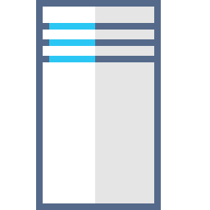

What are Razor Pages?
Razor Pages is a server-side, page-centric programming model for building web UI with ASP.NET Core.
Client Content
Server Code
Notes:
Razor Pages is a server-side, page-centric programming model for building web UI with ASP.NET Core.
Razor Pages use a markup language called Razor for embedding server-based code into webpages. Razor syntax is a combination of HTML and C# where the C# code defines the dynamic rendering logic for the page. In a webpage that uses the Razor syntax, there can be two kinds of content: client content and server code:
Client content: Contains what you're used to in webpages: HTML markup (elements), style information such as CSS, maybe some client script such as JavaScript, and plain text.
Server code: Razor enables you to add server code to your client content. If there's server code in the page, the server runs that code first, before it sends the page to the browser. By running on the server, the code can perform more complex tasks than using client content alone. For example, securely accessing databases. Most importantly, server code can dynamically create client content — it can generate HTML markup or other content and send it to the browser along with any static HTML that the page might contain. From the browser's perspective, client content generated on the server is no different than any other client content.

Slide 10

Benefits of Razor Pages
Makes it easy to get started building dynamic web apps with HTML, CSS, and C#.
Encourages organization of files by feature, which eases maintenance of your app.
HTML + server-side C# code by using Razor syntax.
Notes:
Razor Pages provide the following benefits:
Makes it easy to get started building dynamic web apps when all you need is to define UI logic using a combination of HTML, CSS, and C#.
Encourages organization of files by feature, which eases maintenance of your app.
Can be broadly described as an HTML file in which you work with markup as you're used to. You also have the advantage of adding server-side C# code by using Razor syntax.
Razor Pages use a markup language called Razor for embedding server-based code into webpages. Razor syntax is a combination of HTML and C# where the C# code defines the dynamic rendering logic for the page. In a webpage that uses the Razor syntax, there can be two kinds of content: client content and server code:

Slide 11
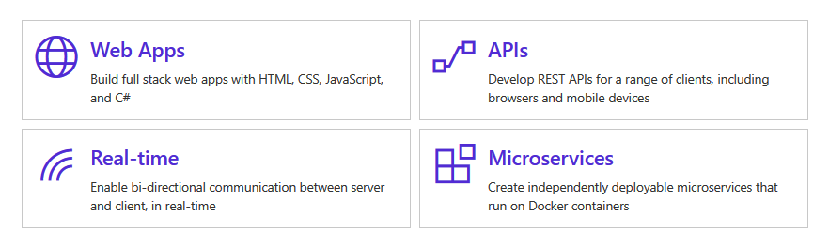
When to use Razor Pages
Blazor
MVC
Razor Pages
Appropriate for client-heavy SPA (single page app) scenarios as React and Angular.
Server-side, organized by controllers.
More structured scenarios, original basis of Razor Pages.
Server-side applications that are organized by feature. Easy to start, scales to large applications.
Notes:
Use Razor Pages in your ASP.NET Core app when you:
Want to generate dynamic web UI from your ASP.NET Core app.
Prefer a page-focused approach to developing web apps, where the page markup and PageModel are in close proximity.
Want your page-focused ASP.NET Core app to use partial views — mechanisms for reducing duplication of common markup across the site.
Razor Pages allow you to keep your ASP.NET Core pages organized in a simpler way:
All view (page) specific logic and page properties defined in the Razor page's (PageModel) can be kept together in their own namespace and directory.
Groups of related pages can be kept in their own namespace and directory.
[!NOTE] ASP.NET Core also supports the MVC pattern for building web apps. The Model defines the fundamental behaviors and data for the app and its components. The View uses HTML and Razor syntax to provide the UI. The Controller is a class that receives HTTP requests and handles user actions.
Use ASP.NET Core MVC when you prefer to build web apps with a clear separation between the Model, View, and Controller.
Razor Pages is built on the same infrastructure as ASP.NET Core MVC. Both Razor Pages and MVC can be used within the same ASP.NET Core app. ASP.NET Core MVC is outside of the scope for this module.

Slide 12
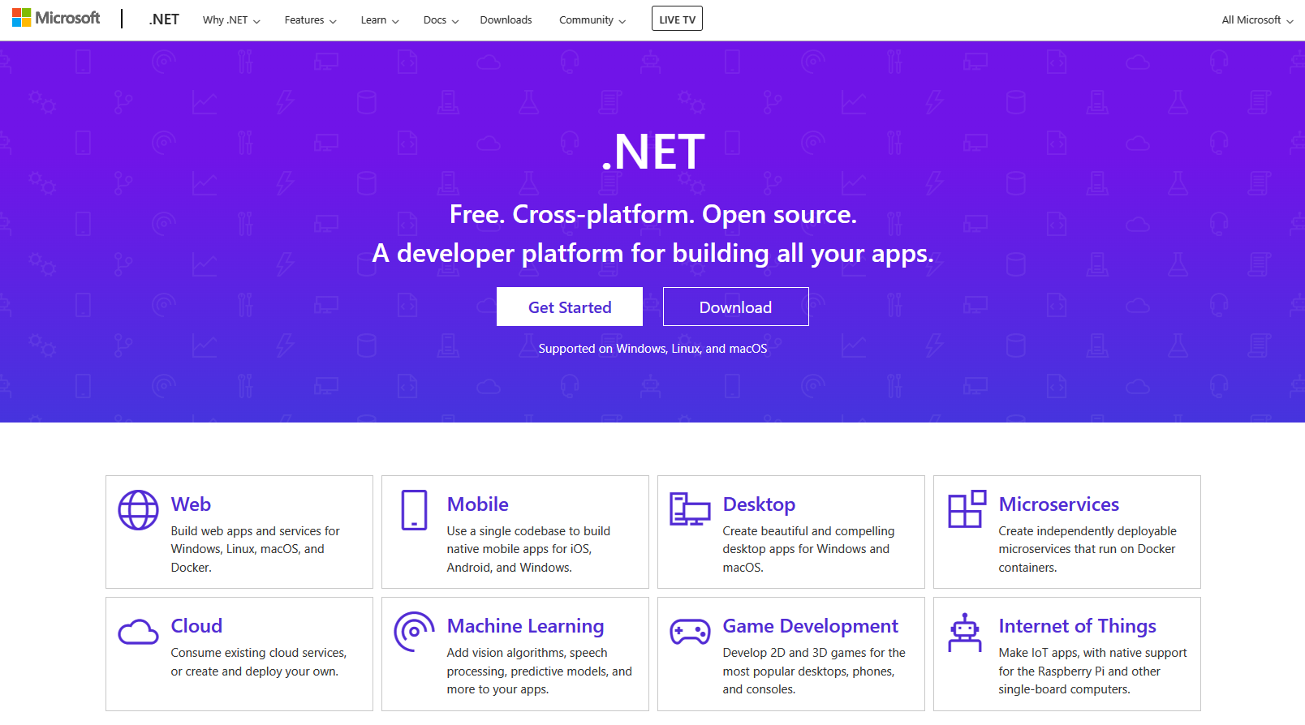
.NET Website
Notes:
Use Razor Pages in your ASP.NET Core app when you:
Want to generate dynamic web UI from your ASP.NET Core app.
Prefer a page-focused approach to developing web apps, where the page markup and PageModel are in close proximity.
Want your page-focused ASP.NET Core app to use partial views — mechanisms for reducing duplication of common markup across the site.
Razor Pages allow you to keep your ASP.NET Core pages organized in a simpler way:
All view (page) specific logic and page properties defined in the Razor page's (PageModel) can be kept together in their own namespace and directory.
Groups of related pages can be kept in their own namespace and directory.
[!NOTE] ASP.NET Core also supports the MVC pattern for building web apps. The Model defines the fundamental behaviors and data for the app and its components. The View uses HTML and Razor syntax to provide the UI. The Controller is a class that receives HTTP requests and handles user actions.
Use ASP.NET Core MVC when you prefer to build web apps with a clear separation between the Model, View, and Controller.
Razor Pages is built on the same infrastructure as ASP.NET Core MVC. Both Razor Pages and MVC can be used within the same ASP.NET Core app. ASP.NET Core MVC is outside of the scope for this module.

Slide 13

Create new ASP.NET Core app
Create a web app project
Run and explore the Razor Pages project
Imagine you're an employee of a pizza company named Contoso Pizza.
Compile and run the project
Tour the app
Notes:
This slide sets up the context BEFORE the demo, and provides a summary AFTER the demo
https://docs.microsoft.com/en-us/learn/modules/learn-pr/3-exercise-create-new-aspnetcore-app

Slide 14
Add a Pizza list page with a form
Create a page
Add Pizza and PizzaService classes
Add form markup to the Pizza Razor page
Review Razor Tag Helpers
In this unit, you'll create a form in the RazorPagesPizza project using Razor Pages to separate the logic of the page from its presentation.
Notes:
This slide sets up the context BEFORE the demo, and provides a summary AFTER the demo
https://docs.microsoft.com/en-us/learn/modules/learn-pr/5-exercise-create-new-razor-page-and-form

Slide 15
Handle the Pizza form submission
Examine the PageModel class
Update Get page handler to display the list of Pizzas
Update the OnGet page handler
Use a utility method to format Gluten Free
Add Post page handler to the PageModel
Bind the model
Add an HTTP POST handler for the Delete buttons
In this unit, you'll add a HTTP POST page handler for the Pizza Razor page form.
Notes:
This slide sets up the context BEFORE the demo, and provides a summary AFTER the demo
https://docs.microsoft.com/en-us/learn/modules/learn-pr/7-exercise-create-pagemodel

Slide 16

Exercise
Create a new ASP.NET Core app Add a Pizza list page with a form Handle the Pizza form submission
Notes:
Link to published module on Learn: https://docs.microsoft.com/en-us/learn/modules/learn-pr/5-exercise-create-new-razor-page-and-form

Slide 17

Summary
Understand when and why to use Razor Pages.
Use the .NET CLI to create a new page in the app.
Create a form that supports the app's requirements.
Add client-side form input validation using Tag Helpers.
Add server-side model validation using data annotations.
Run and test the web app.
Notes:
In this module, you examined the Razor Pages architecture in an ASP.NET Core app. This app provided a UI for updating and deleting product listings exposed through a web API endpoint. You added a product creation form, taking advantage of Razor Tag Helpers. With Tag Helpers, you quickly added client-side and server-side validation. You also gained cross-site antiforgery validation. You coded its PageModel class that provided a separation of concern for the page's logic operations and data properties.

Slide 18
/learn
https://aka.ms/dotnet-conf-webUI
Complete interactive learning exercises, watch videos, and practice and apply your new skills.
Notes:
What is a Learn Module
Promote the Learn module. Encourage the audience to complete the module AFTER the session. They’ll be able to do everything that we’re doing here today, and get hands-on experience to reinforce their learning.

Slide 19
Resources
➡️
Let’s Learn .NET: Razor Pages
aka.ms/lets-learn-razor-pages
➡️
.NET Website – ASP.NET
dotnet.microsoft.com/apps/aspnet
➡️
ASP.NET Learning Resources
dotnet.microsoft.com/learn/aspnet

Slide 20







Modern Web Development with .NET 6
Scott Hanselman
Maira Wenzel
5-part series, starting Monday, November 15 @ 2:00pm Pacific
Register Now :
https://aka.ms/LearnLive-MWD-withdotNET6
Jon Galloway
Jeff Fritz
Jon Galloway
James Montemagno
Matt Soucoup
Notes:
Create a web UI with ASP.NET Core: November 15 – Episode 01 (2:00pm PT – 3:30pm PT)
Build a web app with Blazor: November 22 – Episode 02
Create a web API with ASP.NET Core: November 29 – Episode 03
Publish a Blazor WebAssembly app and .NET API with Azure Static Web Apps: December 6 – Episode 04
Build your first microservice with .NET: December 13 – Episode 05

Slide 21
Q&A

Slide 22

Thank you!
Jon Galloway & Maira Wenzel

